Slide 1



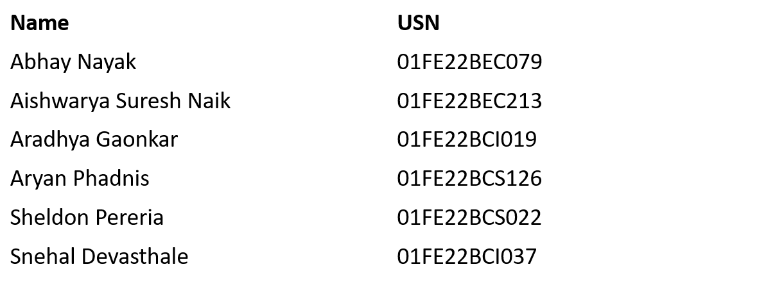
Internal hackathon
Problem statement id: 25175
Title: MAITRI : An AI Assistant for Psychological & Physical Well-Being of Astronauts
Theme: Space Technology
Category: Software
Team no:103
Team name: Penguino
Team details:

Slide 2
Content:
1. Background
2. Why we need to solve this issue?
3. Existing Solutions
4. Problem statement description
5. Proposed solution
6. Expected Outcomes
7. Impact

Slide 3
Background:
Problem: Machines struggle to recognize human emotions reliably, yet emotion understanding is key for human-computer interaction.
Existing approaches : Audio-only and video-only methods exist, but each has limitations in accuracy and robustness.
Gaps : Current systems often ignore multimodal cues, rely on small datasets, and lack generalization to real-world settings.
Need: A multimodal (audio + video) system can capture richer emotional signals, leading to higher accuracy and broader applications in healthcare, education, and AI assistants.

Slide 4
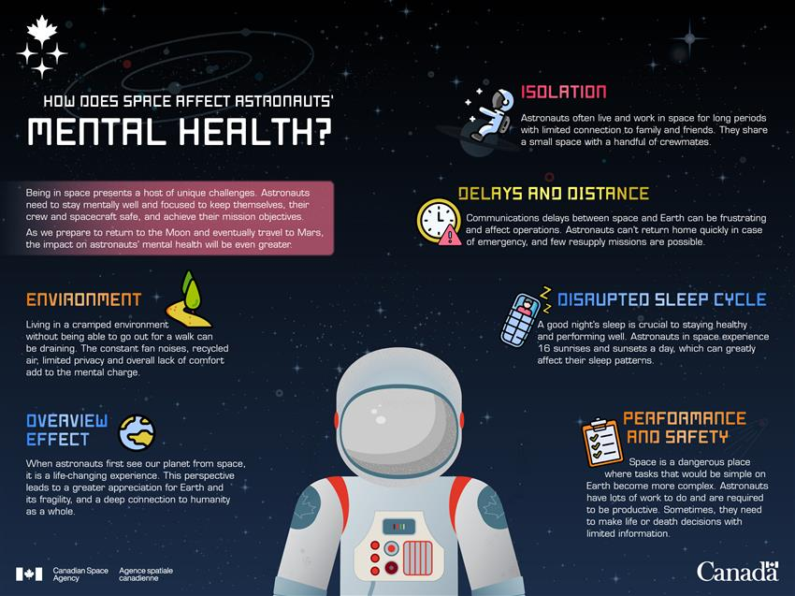
Why we need to solve this issue?
Astronauts experience isolation, confinement, and communication delays during long missions.
Prolonged stress and sleep disruption impair performance, decision-making, and health.
Current psychological monitoring relies on manual self-reports or ground-based assessments, which are slow and subjective.
No real-time AI-driven emotional support system is currently deployed in space missions.
Existing tools (wearables, surveys, basic monitoring apps) lack multimodal emotion analysis and adaptability to extreme conditions.
https://www.asc-csa.gc.ca/eng/youth-educators/toolkits/mental-health-and-isolation/how-space-and-isolation-affect-astronauts-mental-health.asp

Slide 5
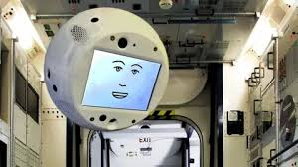
Existing solutions:
NASA & Google’s Crew Medical Officer Digital Assistant (CMO-DA): An AI medical assistant designed to help astronauts diagnose and treat symptoms autonomously.
Akin’s AI Robots: AI robots support astronauts both technically and emotionally on complex space missions.
CIMON-2 by IBM and the German Aerospace Center : An AI-powered robot that assists astronauts with tasks and provides emotional support.
https://www.bbc.com/news/technology-44655675

Slide 6
Problem statement description
Crew members onboard space stations face isolation, sleep disruption, tight schedules, and physical discomforts.
These factors can trigger psychological issues, stress, and errors in performance if not addressed early.
There is currently no dedicated AI-based assistant to continuously monitor and support astronaut well-being.
What’s Needed?
An AI companion that can engage astronauts in short, meaningful conversations.
A system to detect emotions in real-time using voice and facial cues.
Ability to provide psychological support and maintain emotional balance.
Early detection of critical issues and reporting them to mission control.
Assistance in reducing discomfort and improving morale during long missions.

Slide 7
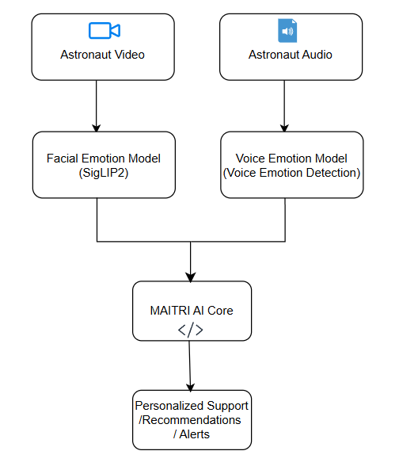
Proposed solution
Multimodal Emotion Recognition: Combines facial (SigLIP2) and voice (Voice Emotion Detection) analysis for real-time emotion capture.
Continuous Monitoring: Tracks emotional cues throughout missions to detect stress, anxiety, or fatigue.
Personalized Support: Provides tailored coping strategies, conversation prompts, and relaxation guidance.
Adaptive Interaction: Engages astronauts through meaningful dialogues based on current mood and context.
Early Alerts: Flags critical psychological risks to mission control for timely intervention.

Slide 8
Expected Outcomes
24/7 Accessible Support : Instant mental health guidance anytime
Personalized & Empathetic Responses : Tailored to user emotions
Higher Engagement : Users stay connected and build trust
Early Intervention : Timely detection of stress or harmful patterns
Scalable & Inclusive : Support for many users, reducing stigma

Slide 9
Impact:
Boosts Astronaut Well-being : reduces stress, anxiety, and sleep issues
Enhances Mission Performance : healthier crew → fewer errors, better focus
Provides Continuous Support : fills gap left by delayed ground monitoring
Adaptable : can extend to other high-stress, isolated environments
Informs Mission Planning : data-driven insights for schedules and crew support

Slide 10
THANK YOU

